Slide 1

ডকুমেন্টারির ডিসকোর্স ০১
সৃজনীশলতা - বাস্তবতা
আসল/সত্য - ন্যায়
ফিকশন – নন ফিকশন
বাইনারি – নন বাইনারি

Slide 2
Manifestly Radical
A Foreword BILL NICHOLS
বাস্তবতা
Her attack on realist documentary is merciless, fully in the no- holds barred spirit of most manifestos. Since the time of Robert Flaherty’s Nanook of the North (1922), realism in documentary has meant falsification. Dominant conventions of realism move toward pornography in which the people in a documentary, like the women in a Playboy centerfold,
are reduced to their usefulness to the filmmaker and his vision (these works are predominantly by men). This, she argues, is pornography. A pornography of the real (NICHOLS&Godmilow 2022:Xii-Xiii).
Conventional documentaries typically exhibit a narrative with a beginning that demands an ending which resolves the issue identified at the start, a resolution that belongs fully to the world of fiction rather than to a reality where problems persist long after the completion of
the film. Real issues cannot be reduced to the damage incurred and obstacles faced in individual cases and specific instances, nor can they be resolved within an hour or two of screen time (NICHOLS&Godmilow 2022:Xiii).
This is heady stuff and clearly meant to shake us up. But Godmilow has an alternative to propose, and this is where her manifesto takes us down a road that moves through less well- known terrain, the postrealist landscape of films that focus less on what we must attend to out there in the world and more on what we must attend to about the process
of watching documentaries that claim to represent that world. Resist, refuse, rebel might be her mantra. Resist conventional strategies, refuse realist pretenses, rebel and find a better way (NICHOLS&Godmilow 2022:Xiii)..

Slide 3

অর্ধসত্য

Slide 4
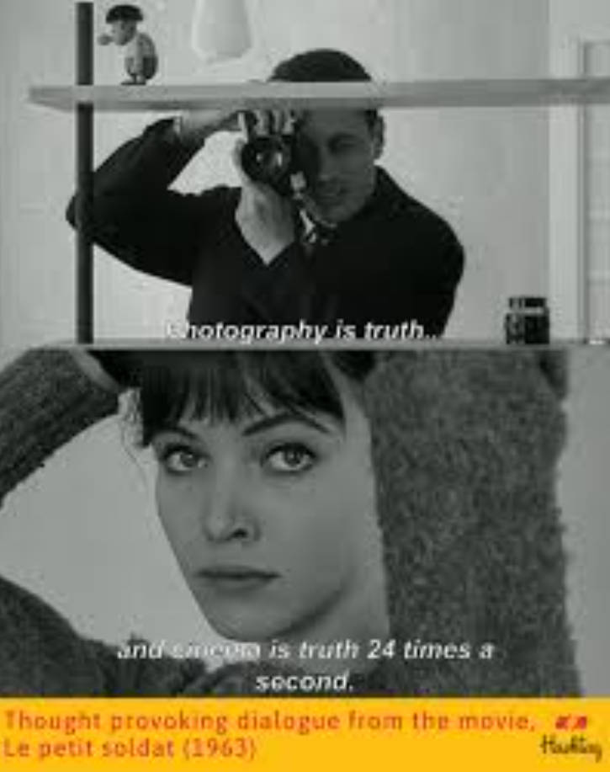
“Film is 24 lies per second at the service of truth, or at the service of the attempt to find the truth.”
― Michael Haneke
Photography is truth. The cinema is truth twenty-four times per second.

Slide 5
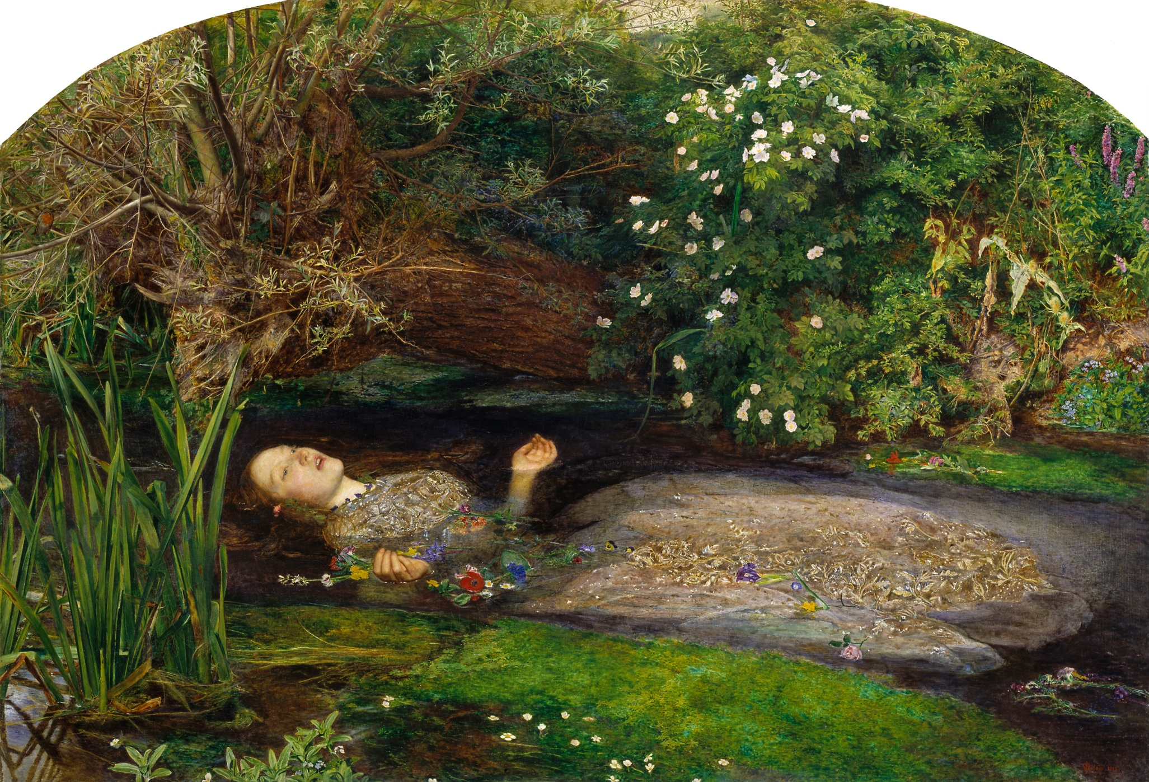
আসলের অনুভূতি

Slide 6

Notes:
সত্য কি নির্মাতা নিরপেক্ষ? নাকি নির্মাতার দৃষ্টিভঙ্গি ও দায়?

Slide 7
সত্য হলো ফিকশনাল ন্যারেটিভ যার মাধ্যমে আমরা ঘটনার নানাদিক সম্পর্কে ধারণা পাই। অর্থ্যাৎ ন্যারেটিভ এবং কনটেক্সট তৈরি করা না হলে একটি ঘটনার কোন ইমেজ বা ডকুমেন্ট দিয়ে নির্দিষ্ট করে কিছু না বুঝিয়ে অনেককিছুই বোঝাতে পারে (Bruzzi 2006: 16)।

Slide 8
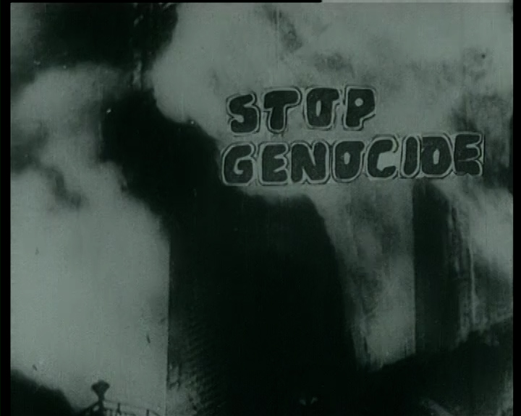
ন্যায়

Slide 9
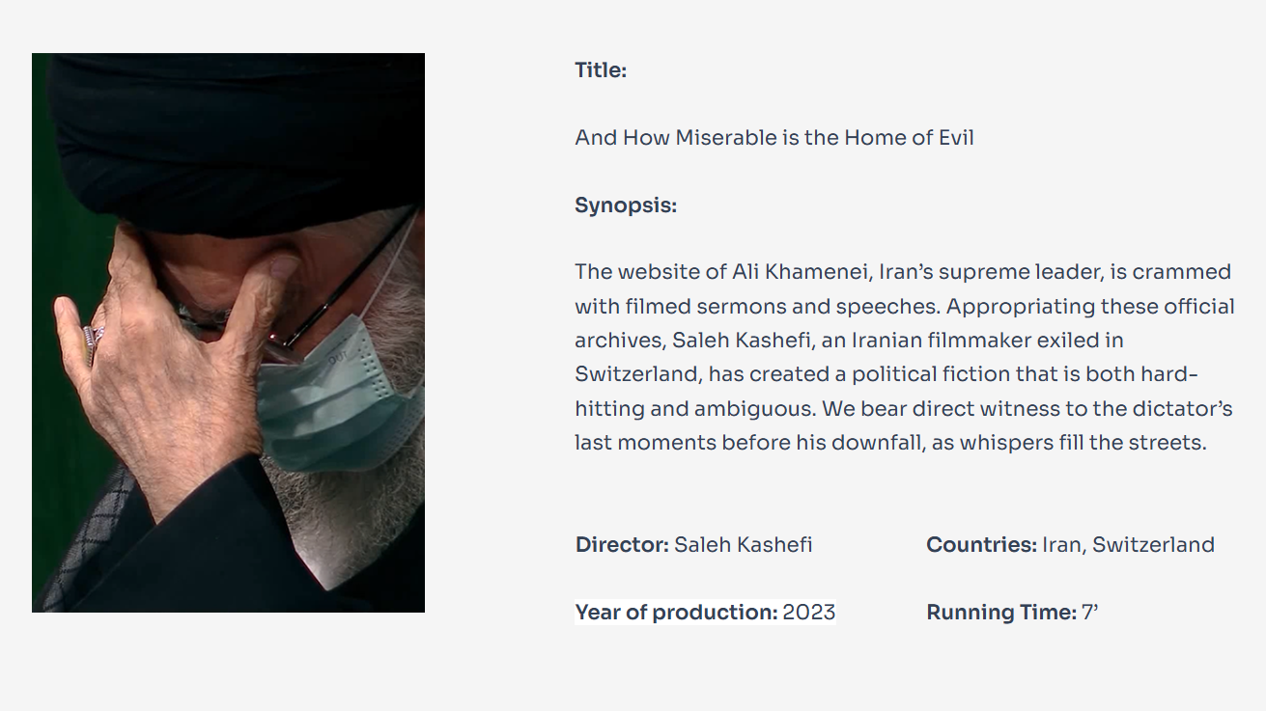
What we normally think of as “the real” in documentary films is a construction, made up of how well the look and the sound of the film simulates the actual.

Slide 10
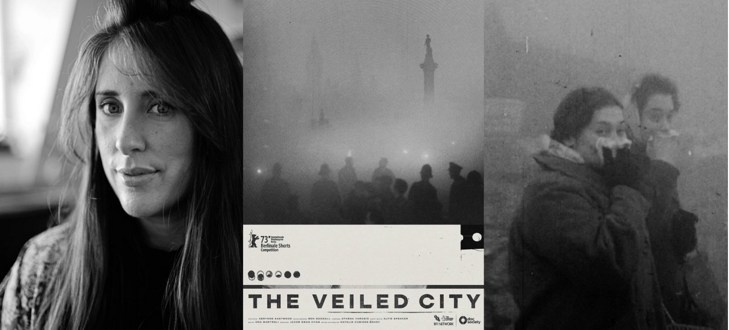
A speculative city symphony inspired by London’s Great Smog of 1952. Merging reality with fiction, THE VEILED CITY invites us to understand the smog in the context of the present-day climate crisis.

